Slide 1
The social protection system for children in Spain. Measures and resources
María Jesús García Soto
Deputy Director of the CIPFP Valle de Elda
Spain
Moscow 21st November 2019
Notes:
1
Good morning
My name’s Cristóbal Melgarejo
I’m a teacher of technologies in a Secondary School of Spain
I’m the headteacher of the IES Valle de Elda.
I would like to tell you about these points

Slide 2
Index
Our College and our courses
Protection measures for children in Spain
Judicial measures for young offenders in Spain
Notes:
2

Slide 3
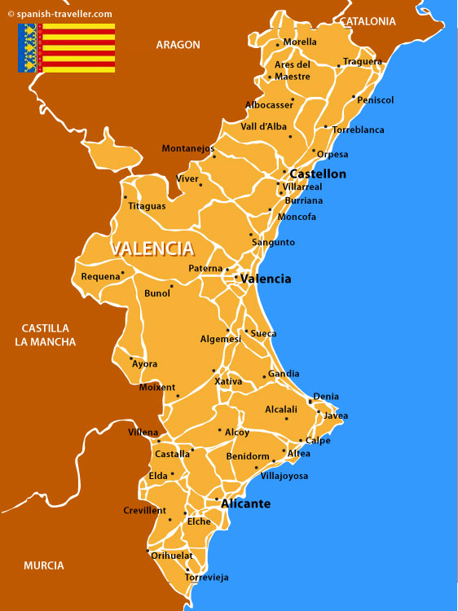
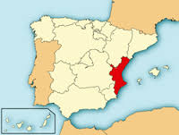
Where’s our College?

Slide 4
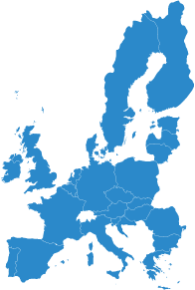
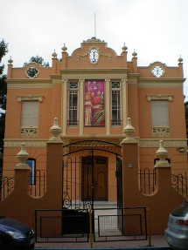
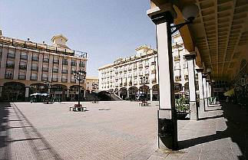
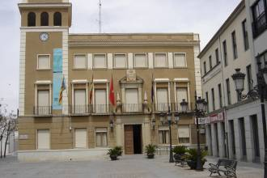
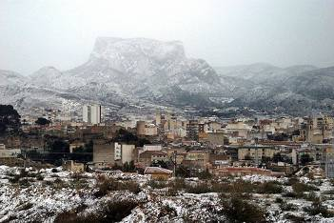
Where’s our College?
Notes:
4
My Secondary School is located in Elda, a city near Alicante in southeast Spain.This city has a population of 56,000 inhabitants and 5 secondary schools, 4 of them including Vocational Training Programmes.
4

Slide 5
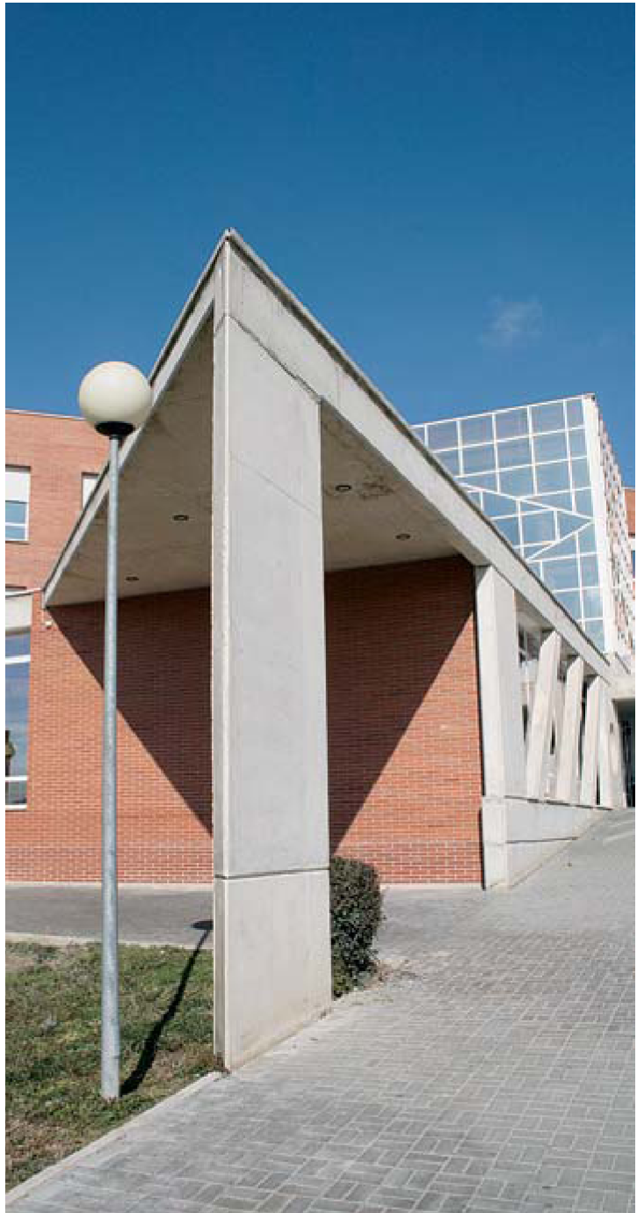
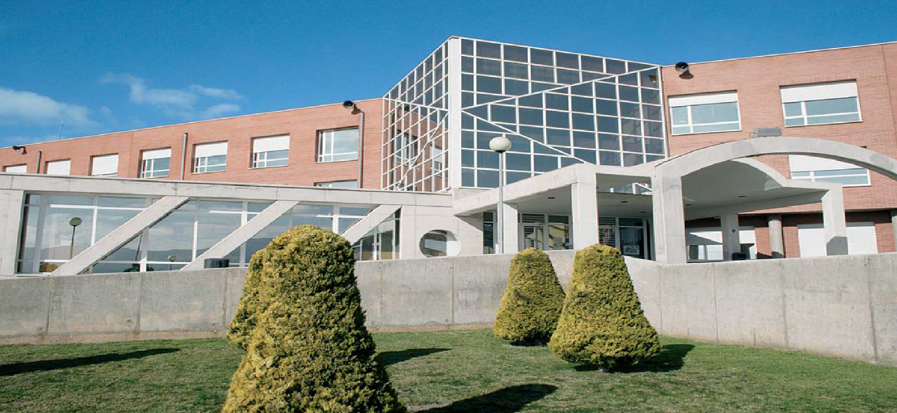
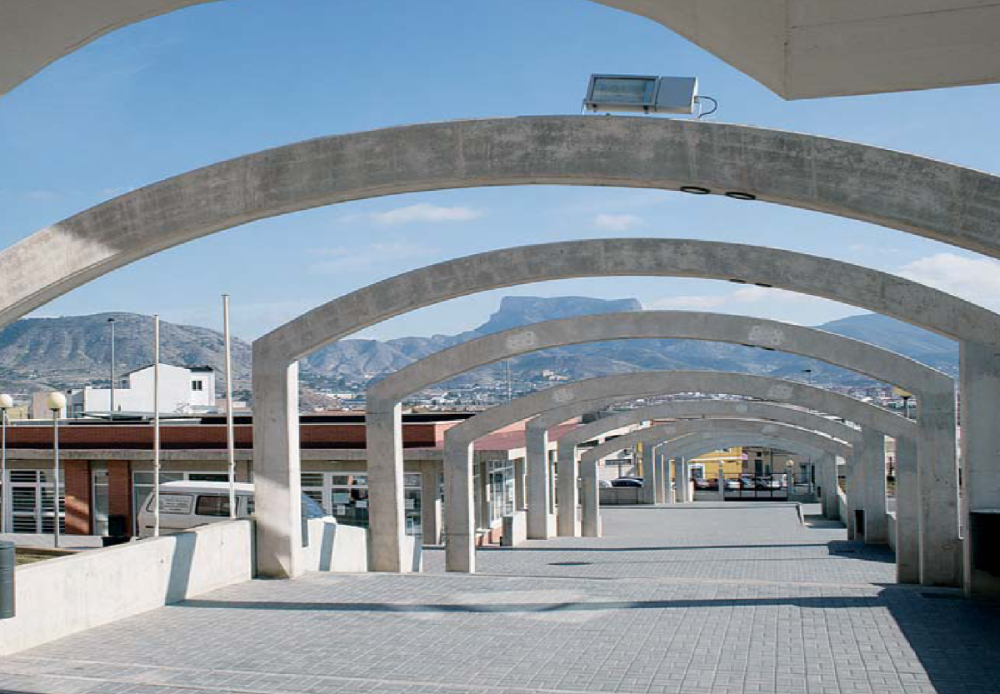
What’s our Center like?
Notes:
5
You can see some images of the differents buildings of my school
5

Slide 6
What’s our College like?
Some numbers
1000 students:
945 Vocational Training Programmes (FPB, CFGM and CFGS)
55 Unemployed courses
101 teachers
Notes:
6
My institution has 930 pupils and 103 teachers. Approximately 450 are studying Compulsory Secondary Education (12 to 16 years old), about 130 Higher Secondary School (Bachillerato) aged 16-18 years old and the remaining 350 students are studying Vocational Training Programmes.
You can see some pictures of differents activities about my school
6

Slide 7
ESTUDIES SOCIOCULTURAL DEPARTMENT
Social Integration
Sociocultural and Tourism Animation
Pre-primary Education
Promotion and gender equality

Slide 8
Level 3: ADVANCED LEVEL VOCATIONAL TRAINING (CFGS)
PLACE IN THE SYSTEM | Upper Higher Secondary Education (bachillerato) or Intermediate Level Vocational Training
DIPLOMA RECEIVED | Superior Technician in the corresponding profession
PLACE WHERE TRAINED | Education centres and workplace
DURATION | The new diplomas are 2,000 hours. Normally they last two years. Between 300 and 700 of these hours are dedicated to in-company training (Workplace Training Module).
GROUP AIMED AT AND AGE OF STUDENTS | 18 years and over
CENTRES | Public and private vocational training centres Specialized centres or centres teaching other programmes. Normally offered together with compulsory secondary education and Bachillerato in the secondary schools called "institutos de educación secundaria“ .
ENTRY REQUIREMENTS | Diploma of Bachillerato Intermediate Vocational Training Technician Diploma by test for which it is required to be 18 years of age By Test regulated by the education department, for which it is required to be 19 years of age
TRANSITION TO OTHER STUDIES | Entry to the University

Slide 9
THE COMPETENCES
The Spanish state is organized territorially in three levels from Constitution 1978
State Law 1/96
Autonomous communities Law12/98
City halls
Notes:
9

Slide 10
Protection System
Risk situation
Helplesness situation
Municipal Social Services
Specialized social services of the autonomous communities

Slide 11
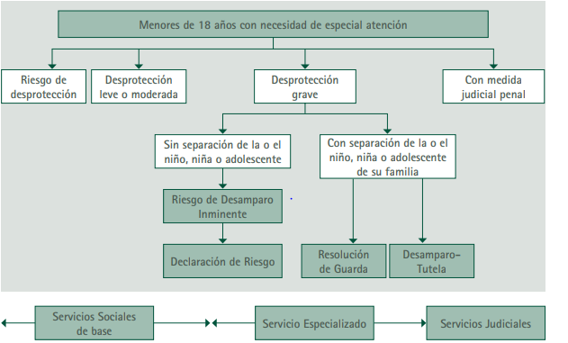
Protection System
Children under 18 years
Risk Situation
Slight lack of protection
Severe Situation of Desprotection
Judicial measures
without separation from the family
with separation from the family
Risk of helplessness
Declaration of risk
Helplessness declaration
Risk of helplessness
Base Social services
Specialized Social services
Judicial services

Slide 12
GENERAL MEASURES
- Family help or support in risk situations.
-The assumption of guardianship by the ministry of the law, prior declaration of the situation of abandonment of the child.
- The guard.
- The foster care.
- The residential care.
- The adoption
Notes:
12

Slide 13
RISK SITUATION
The damage that affects the child does not reach enough severity to justify their separation form family
The assesment, intervention and execution of measures is a municipal competence
Notes:
13

Slide 14
SUPORT MEASURES
- Economic support
- The assistance to educational centers
- The intervention of volunteers
- Home help
- Day care centers
-Social guarantee training programs aimed at adolescents who, leaving the school system
-Orientation, mediation and family therapy programs
Notes:
14

Slide 15
HELPELESSNESS SITUATION
- Occurs in fact due to non-compliance, or the impossible or inappropriate exercise of the protection duties when children are deprived of the necessary moral or material assistance.
-The seriousness of the facts suggests the separation of the child from the family that causes such a situation.
Notes:
15

Slide 16
RESIDENTIAL RECEPTION
The child is received in the center the most appropriate to their specific needs, is closer to their family or social environment, unless the the child's interest requires otherwise. In any case, the Public Administration will ensure that the child remains in a center for as little time as possible.
Notes:
16

Slide 17
FAMILY FOSTER CARE: TYPES
1. According to the lenght
2. According to the bond
3. According to whether or not there is parental consent
Notes:
17

Slide 18
FAMILY FOSTER CARE
1. According to the lenght
SIMPLE
<1 YEAR
PERMANENT
PREADOPTIVE
Notes:
18

Slide 19
FAMILY FOSTER CARE
2. According to the bond
EXTENSE
FAMILY
EDUCATING
FAMILY
Notes:
19

Slide 20
FAMILY FOSTER CARE
3. According to whether or not there is parental consent
ADMINISTRATIVE
JUDICIAL
PREADOPTIVE
Notes:
20

Slide 21
INTERDISCIPLINARY TEAM
Overcomes the traditional separation between
the "psychological," the "educational," and the "social," for to propose a model of psycho-social-educational intervention and ecological-systemic.
Notes:
21

Slide 22
INTERDISCIPLINARY TEAM
It is composed by:
Psicologist
Social Worker
Social educator
Social integrator
Notes:
22

Slide 23
INTERDISCIPLINARY TEAM
FHASES OF PROTOCOL OF ACTION
Reception
Research
Evaluation
Proposal for an intervention plan and measure to be taken
File cloasure
Notes:
23

Slide 24
INTERDISCIPLINARY TEAM
Criteria to be taken into account:
Supreme interest of the child
Decisions are taken by a committee on the basis of the reports collected.
Do not separate siblings
No measures can be taken due to economic shortcomings
Notes:
24

Slide 25
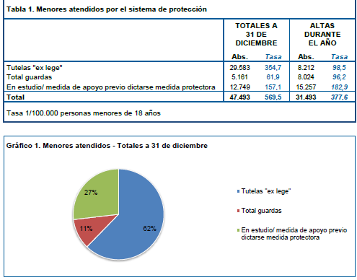
TOTAL NUMBERS
Notes:
25

Slide 26
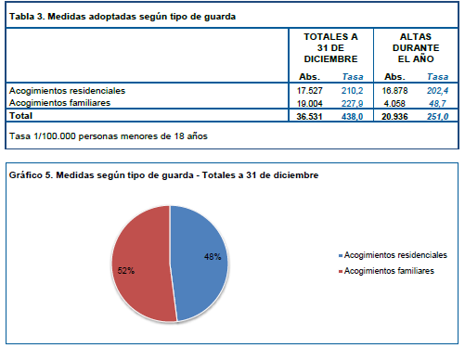
NUMBER OF MEASURES
Notes:
26

Slide 27
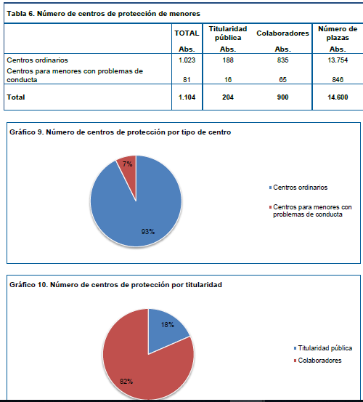
NUMBER OF RESIDENCES
Notes:
27

Slide 28
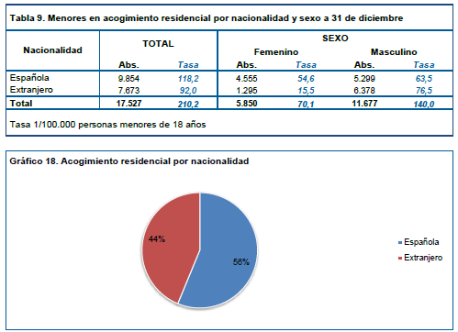
FAMILY FOSTER CARE
Notes:
28

Slide 29
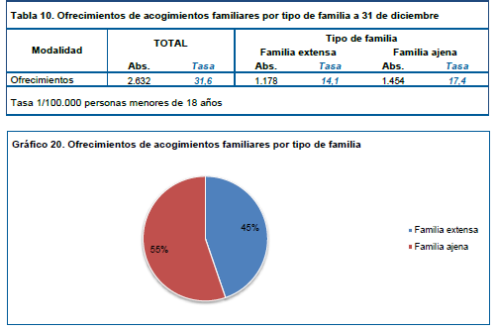
FAMILY FOSTER CARE: TYPES
Notes:
29

Slide 30
Judicial measures for young offenders in Spain
Cristóbal Melgarejo Romero
Director of the CIPFP Valle de Elda
Spain
Moscow 21st November 2019
Notes:
30
Good morning
My name’s Cristóbal Melgarejo
I’m a teacher of technologies in a Secondary School of Spain
I’m the headteacher of the IES Valle de Elda.
I would like to tell you about these points

Slide 31
The Law LO 5/2000 (12th January 2001) and the RD 1774/2004 (30th July) contain the Spanish Government systems for responding to children in conflict with the law.
The Spanish law on juvenile justice was born with a serious aim: to consider that children in conflict with the law need to be dealt with in largely the different way as adults due to their age, their special idiosyncrasy and their hypothetical lack of
maturity or other similar factors.
Notes:
31

Slide 32
There are three keys to understanding the spirit of the law:
* the best interests of the child;
* the aim of Spanish legislation on children offenders: educational and
repressive at the same time;
* the importance of the preventive measures over the punishment itself.
Notes:
32

Slide 33
Criminal Age of Responsibility:
The present Law is applied to call the persons above fourteen years of age and below eighteen years of age to account for the commission of acts classified as offences or faults by the Penal Code.
The term ‘minor’ is used with a general nature to refer to any person whose age is below eighteen years.
Minors below fourteen years of age lack criminal liability; according to the Law, it is stipulated that in these cases minors shall not be demanded liability, but they shall be applied what is provided by the regulations related to the protection of minors.
Notes:
33

Slide 34
Involved Institutions and professionals:
All involved institutions and professionals shall be specialised in the subject.
a. The Prosecution Service: (Ministerio Fiscal) It is the institution in charge of the investigation concerning the criminal proceedings
b. Juvenile Courts: (Juzgado de Menores) These are specialized judicial bodies competent to prosecute minors who have committed a criminal offence, issuing appropriate judgement and ordering its implementation.
c. The Administration of the Autonomous Communities Governments: The implementation of the measures (whether protective or final) issued by the Juvenile Judges in their final judgements is the competence of the Autonomous Communities and the Autonomous Cities of Ceuta and Melilla.
d. Technical Teams:1 (TT) (Equipos Técnicos: ET) These are made up by physiologists, instructors and social workers whose purpose is to provide technical assistance concerning the matters related to their professional disciplines to the Juvenile Judges and the Prosecution Service
e. Other Institutions: The law envisages the possibility of participation of other persons and institutions that might have been related to the minor concerned at any time, to the intents of assessing and
advising the competent institutions on the most appropriate response to the juvenile offender.
Notes:
34

Slide 35
Type of judicial measures for young offenders
º
Deprivation Of Liberty
Therapeutic Measures
Non-custodial Measures
Action by Restriction of Their Rights
Notes:
35

Slide 36
DEPRIVATION OF LIBERTY | CHARACTERISTICS
Closed internment regime | They reside in the center and develop in the same formative, educational, employment and leisure activities
Semi Internment Regime | They reside in the middle, but made out of the same formative, educational, employment and leisure activities
Open detention regime | They perform the activities of the educational project on standardized environmental services, residing in the center as habitual residence, subject to the program and the same internal rules
Stay weekend | They remain at home or in a facility up to thirty six hours between the afternoon or Friday evening and Sunday evening, except for the time to be devoted to the socio-educational tasks assigned by the judge
Notes:
36
Good morning
My name’s Cristóbal Melgarejo
I’m a teacher of technologies in a Secondary School of Spain
I’m the headteacher of the IES Valle de Elda.
I would like to tell you about these points

Slide 37
THERAPEUTIC MEASURES | CHARACTERISTICS
Therapeutic internment | They perform specialized educational services or specific treatment aimed at people who suffer from mental abnormalities or disorders, a state of dependence on alcohol, toxic drugs or psychotropic substances, or changes in perception that determine a serious disturbance of consciousness of reality. Alone or as a complement to other measures provided for in this article as applicable. If the person concerned refuses treatment for addiction, the judge must apply another measure suitable to their circumstances
Outpatient treatment | They must attend the appointed with the frequency required by the physicians that attend and follow the established guidelines for proper treatment of the abnormality or mental impairment, addiction to alcohol consumption, toxic drugs or psychotropic substances, or changes in perception center suffering. This measure can be applied alone or in addition to other measures provided for in this article. If the person concerned refuses treatment for addiction, the judge must apply other measures suitable to their circumstances
Notes:
37
Good morning
My name’s Cristóbal Melgarejo
I’m a teacher of technologies in a Secondary School of Spain
I’m the headteacher of the IES Valle de Elda.
I would like to tell you about these points

Slide 38
NON-CUSTODIAL MEASURES | CHARACTERISTICS
Attendance at a day center | They reside in their habitual residence and attend a center, fully integrated into the community, to support activities, education, training, work or leisure
Probation | It should track the implementation of its activities and helping to overcome factors that determined the offense. Undertakes to follow the socio-educational guidelines according to the intervention program developed for this purpose and approved by the juvenile judge.
Services on behalf of the community | The person subject to this measure, which can not be imposed without their consent, has to perform unpaid activities that are directed, social interest or for the benefit of people in precarious situations. It will seek to relate the nature of such activities with the nature of legally injured by the acts committed by the minor
Notes:
38
Good morning
My name’s Cristóbal Melgarejo
I’m a teacher of technologies in a Secondary School of Spain
I’m the headteacher of the IES Valle de Elda.
I would like to tell you about these points

Slide 39
NON-CUSTODIAL MEASURES | CHARACTERISTICS
Making social and educational tasks | Specific activities of educational content aimed at facilitating the development of their social competence
Reprimand | Retribution of the person conducted by the juvenile court judge to make him understand the gravity of the acts committed and the consequences that they have had or could have had, urging him not to commit such offenses in the future.
Deprivation from driving mopeds motor vehicles, or the right to obtain, or administrative licenses for hunting or use of any weapons. | Legal consequence when the crime or offense was committed using a moped or a motor vehicle or a gun, respectively.
Disqualification. | Final deprivation of all honors, jobs and public positions on which is undertaken, whether elective; and the inability to obtain the same or any other honors, public office or employment, and being elected to public office, during the measurement time
Notes:
39
Good morning
My name’s Cristóbal Melgarejo
I’m a teacher of technologies in a Secondary School of Spain
I’m the headteacher of the IES Valle de Elda.
I would like to tell you about these points

Slide 40
Alternatives to the measures. Out-of-Court Resolutions
a. Withdrawal from proceedings: (Desistimiento) Under certain circumstances the Law envisages the possibility to fully close the criminal proceedings whenever, facing minor offences or crimes committed without violence or intimidation, it is possible to correct the behaviour of the juvenile offender within an educational or family environment.
b. Mediation: (Mediación)
i. Conciliation: (Conciliación) There are other times where the legislator deems a criminal behaviour sufficiently reproached once the minor involved acknowledges the damage caused and apologizes to the victim, and such victim accepts such apologies.
ii. Compensation: (Reparación) It is a commitment made by the minor to the victim or injured person to carry out certain actions in the interests of the second or the community; this shall be followed by its effective fulfilment.
iii. Commitment to complete educational activity: In the event the minor undertakes to complete an educational activity suggested by the Technical Team, and he does so, the procedure shall also be finished as a result of such
alternative.
Notes:
40

Slide 41
Some figures:
First, we would note that Spain does not have a major juvenile delinquency problem.
Young people account for a very small percentage of the total number of detainees in the country, that is, 5.5 percent, which is well below the European average of 9.3 percent (Aebi et al., 2014) or 13.0 percent for violent crimes and 21.0 percent for property crimes in the USA (Butts and Evans, 2014).
Notes:
41

Slide 42
Table 1. Measures provided for in Article 7 (LRPM)
 | NOTIFIED |  | EXECUTED
 | Abs. | Rate | Abs. | Rate
Total internments * | 3.747 | 119,0 | 4.182 | 132,9
Probation (Libertad vigilada) | 12.174 | 386,8 | 15.367 | 488,2
Community benefits (Prestaciones en beneficio de la comunidad) | 3.833 | 121,8 | 4.061 | 129,0
Performance of socio-educational tasks (Realización de tareas socioeducativas) | 3.279 | 104,2 | 3.946 | 125,4
Other measures | 3.575 | 113,6 | 4.867 | 154,6
TOTAL | 26.608 | 845,3 | 32.423 | 1.030,1
Rate 1/100,000 people between 14 and 21
*Total de internamientos en régimen cerrado, semiabierto y abierto.
INE 2017
Notes:
42

Slide 43
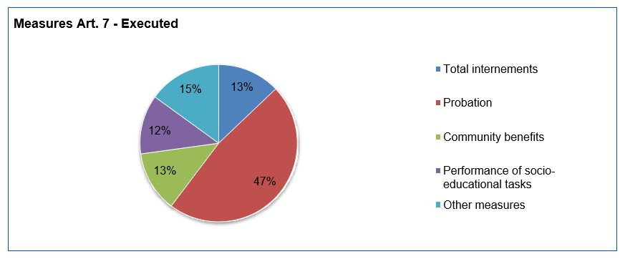
Notes:
43

Slide 44
To sum up
juvenile delinquency has generally declined,
But there are
Increase in sexual abuse, especially among 15-16 year olds.
Assault injuries have highly increased from 2015. It exposes that such violent attitudes highlight a failure of education, of the social system itself, and easy access to alcohol. With regard to the latter, different bodies have already warned of the increase in consumption at an early age.
Cybercrime in minors. According to data from the Ministry of the Interior show, although they do not represent more than 2%, they have been increasing in recent times, and the tendency is to increase, if not to stop.
Notes:
44

Slide 45
The educational system and the system of socialising parents can be a key element in reducing juvenile delinquency and improving society.
Through education and vocational training programmes the trend can be reversed to residual juvenile delinquency.
Schools, social centres and the family must be coordinated to programme prevention policies if the downward trend in absolute terms is to be maintained and other offences are to be prevented from increasing.
An adequate education is the best antidote for any criminal activity, but also for a society based on respect, responsibility and coexistence.
Notes:
45

Slide 46
Thank you for your attention
Notes:
46
46

